Slide 1
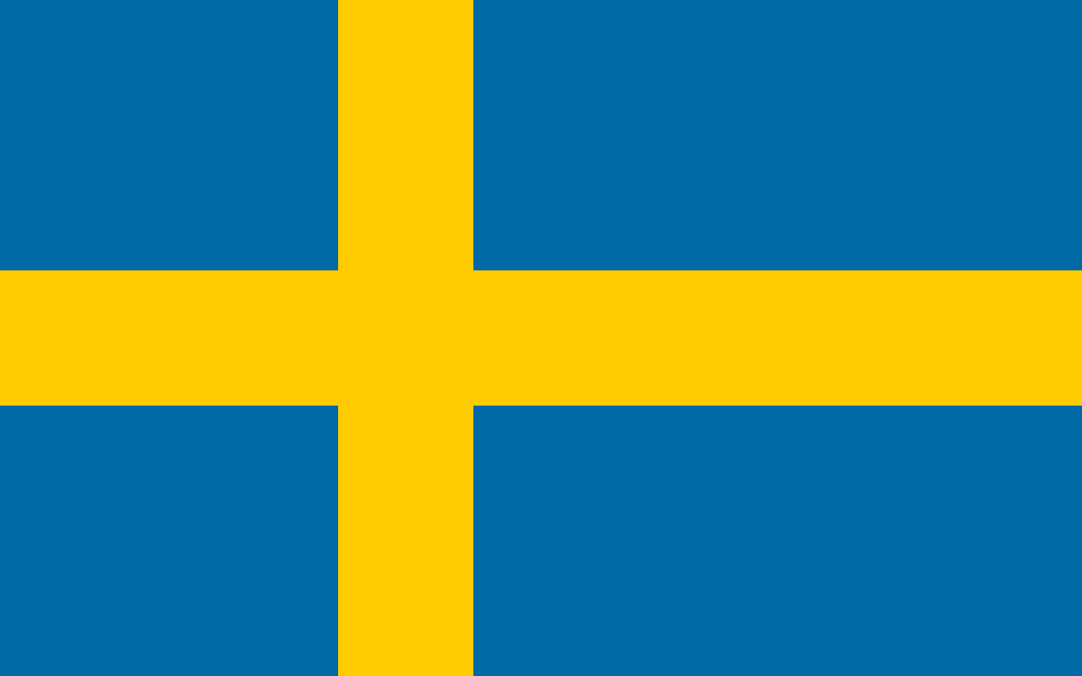
Sweden’s Human and Natural Geography
By Andrew Garber

Slide 2
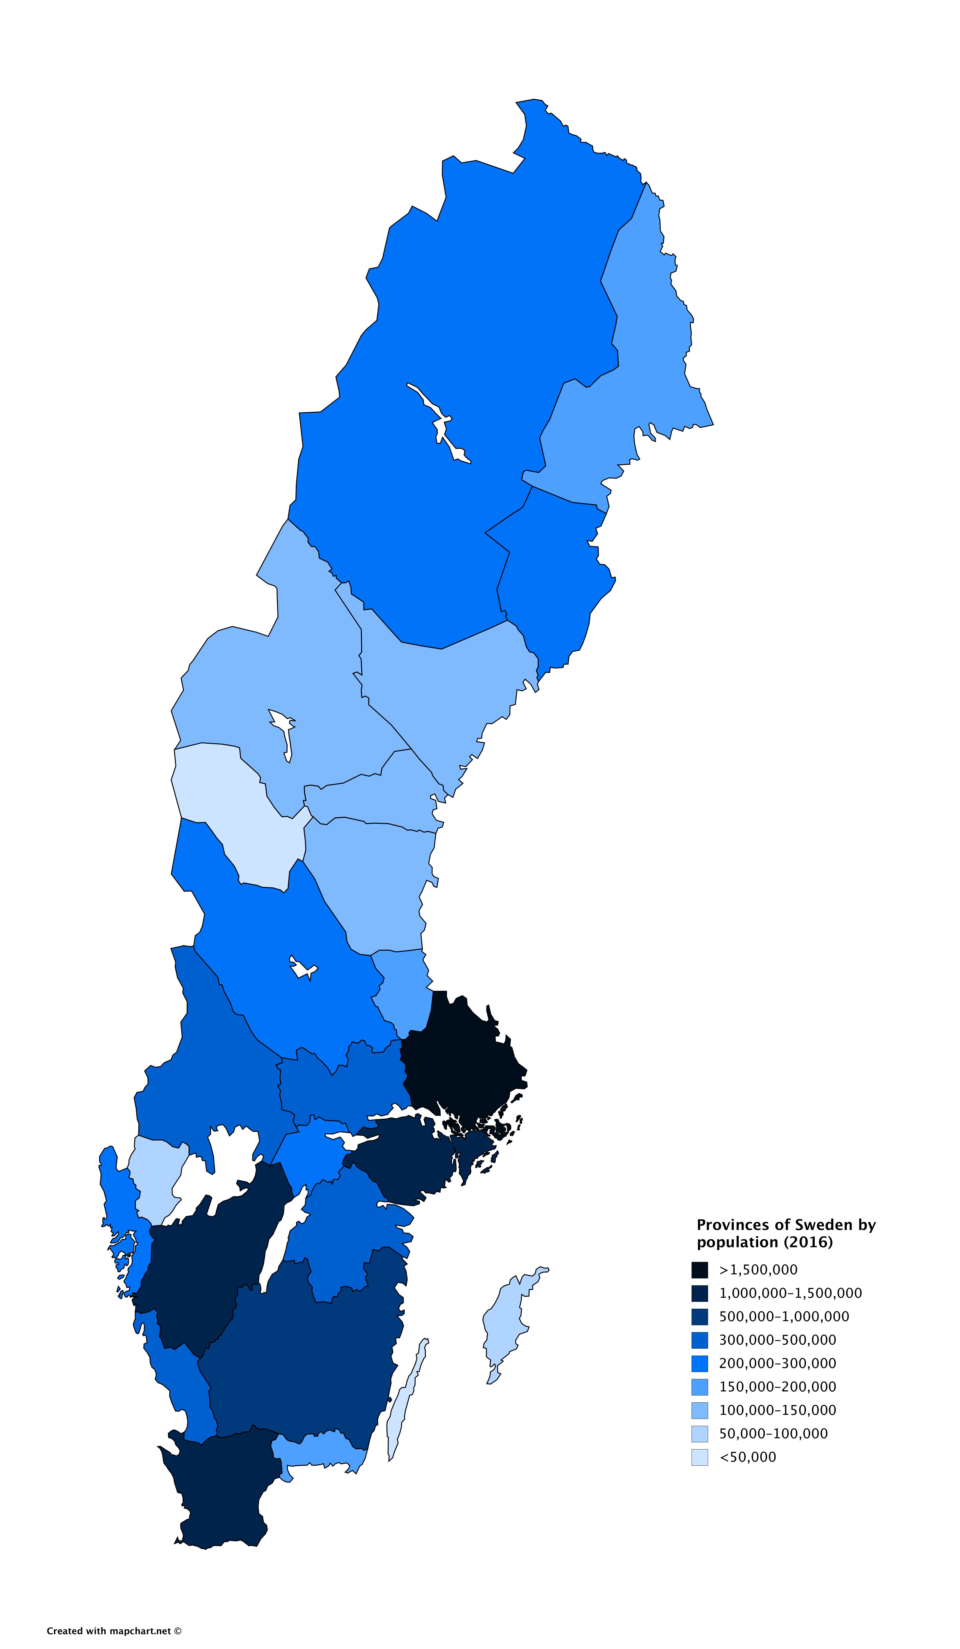
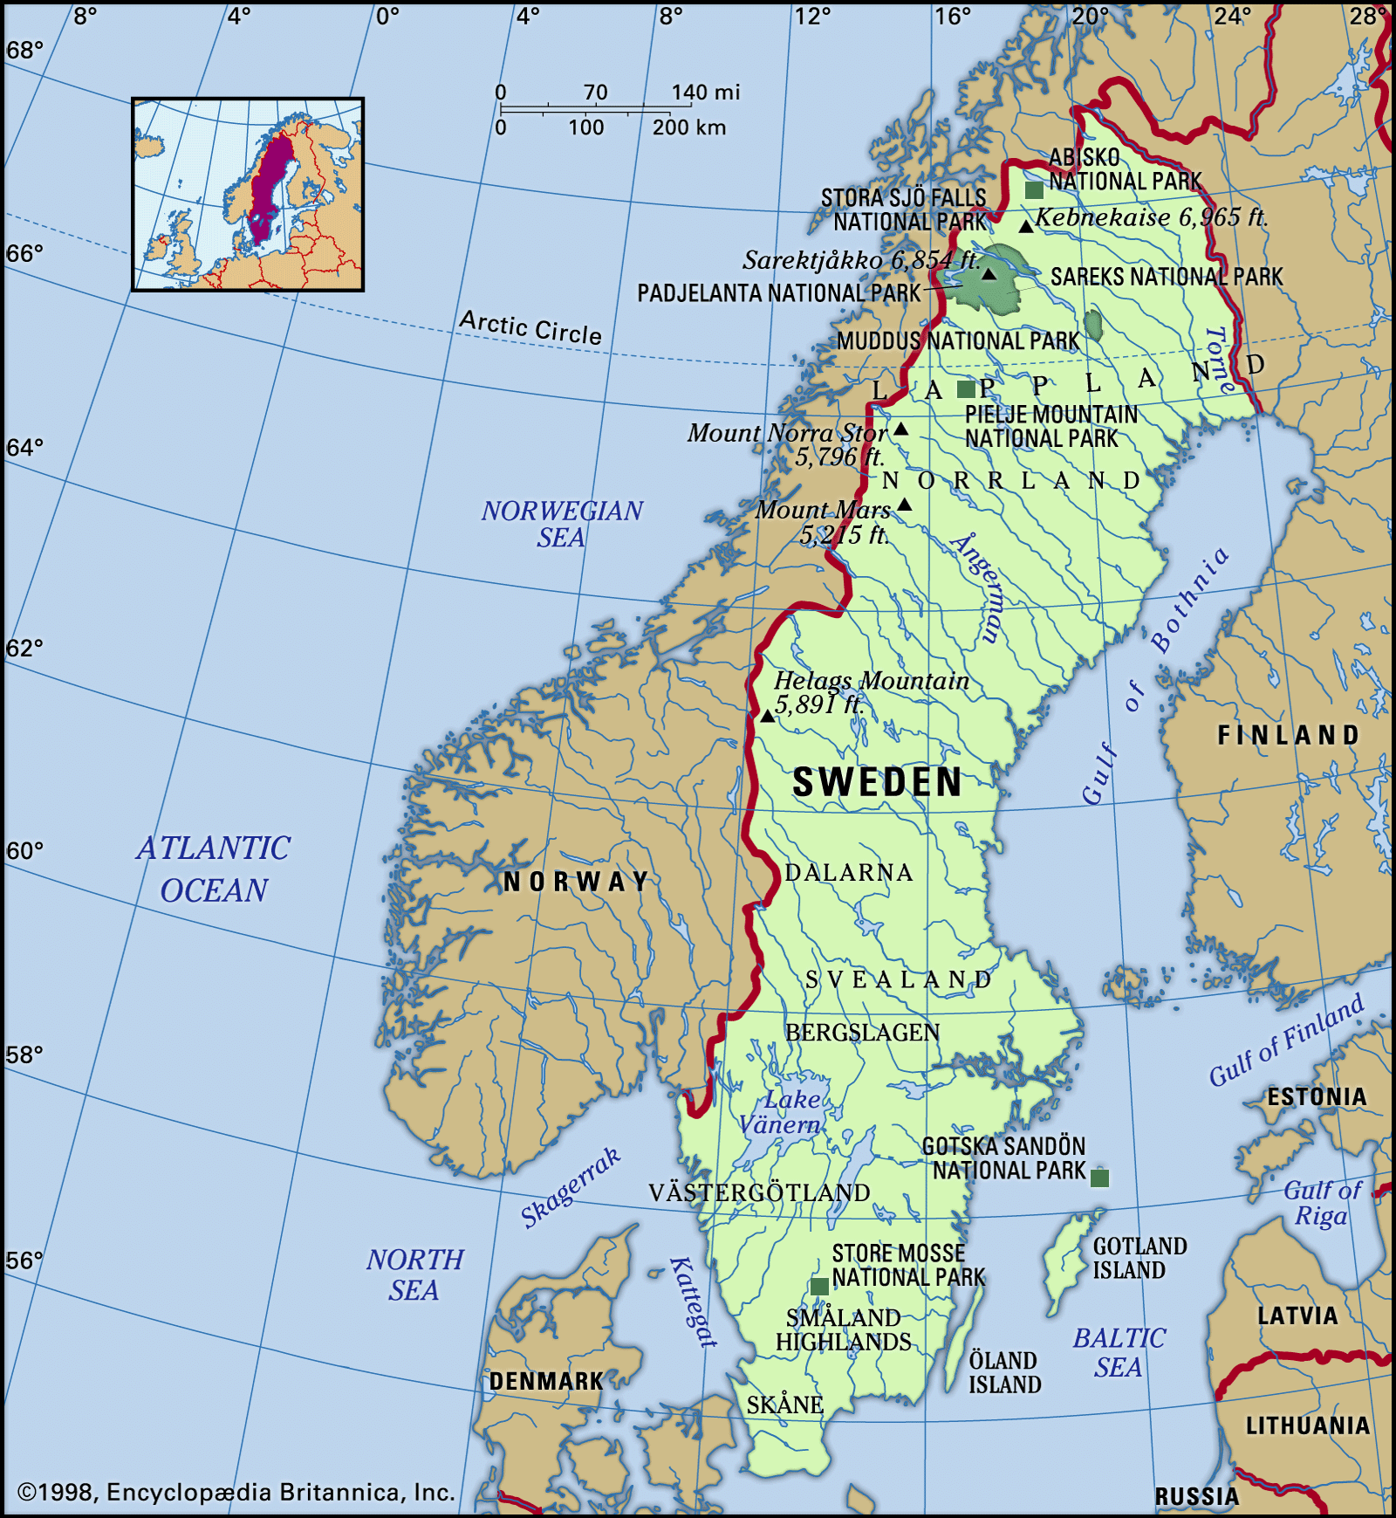
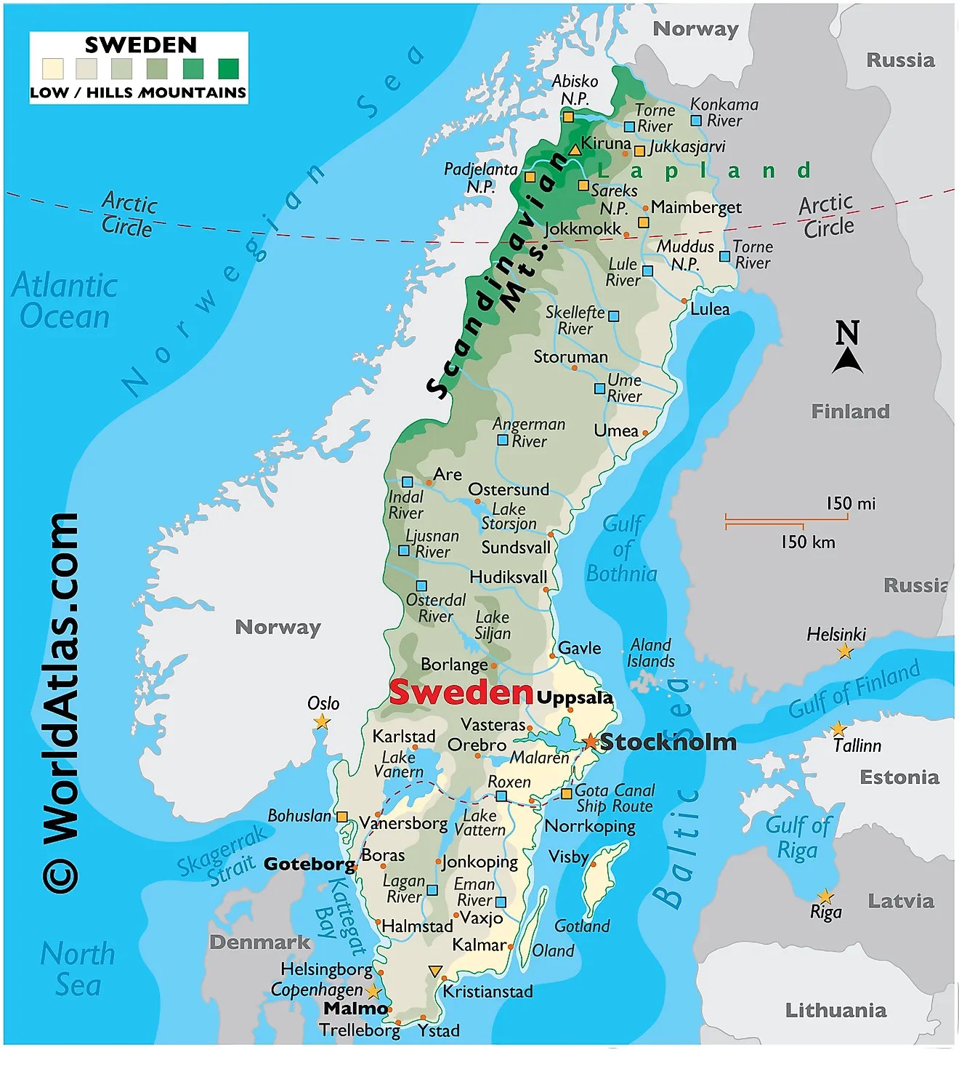
Maps of Sweden

Slide 3
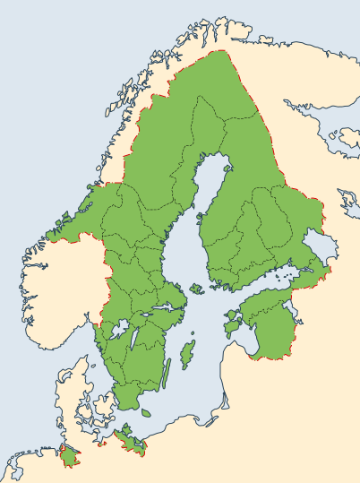
Fun Fact: Sweden used to be huge
The Swedish Empire used to be huge, and it even controlled Poland and much large swathes of Russia for a while.

Slide 4
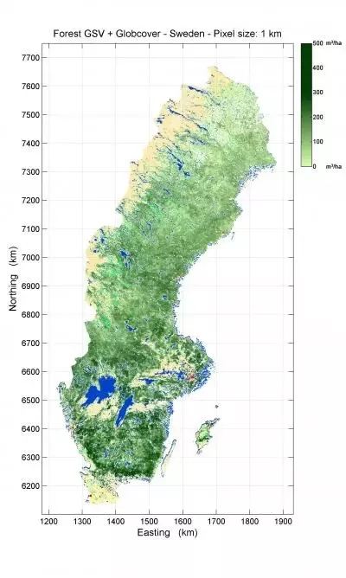
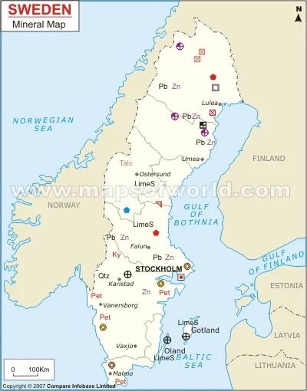
Important Geographical Features
The most important parts of Sweden’s geography are threefold.
1. Sweden is largely bare forests, and it gets frighteningly cold in the winter. Making it not great for large agriculture of large populations.
2. Sweden has lots of natural resources. Fishing, forestry, and MINING. This has had geopolitical implications.
3. Access to the Baltic: Sweden has a huge Baltic coastline, but no access to the open ocean – it has to go through Norway or the straights in Denmark.

Slide 5
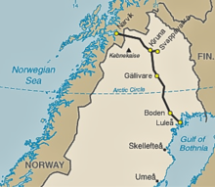
Gällivare Iron Fields
The Gällivare iron fields were absolutely essential to the German war effort in WW2 – the British landed in Norway purely to try and seize them, and Germany invaded Norway just to protect them. They have proven to be some of the highest quality producers of Iron and Steel since.

Slide 6
The End! Sweden is pretty cool, huh?

